Slide 1
How to Organize and Execute a Themed Camporee
Terry McKibben
Assistant Scoutmaster
BSA Troop 344/9344
Pemberville, OH
troop344leaders@gmail.com

Slide 2
Purpose of the Camporee
Camporees are a chance to join in one of the oldest traditions in Boy Scout history – Coming together as a District for Scouting competition.
District gatherings provide an opportunity to match skills against others within our district.
Camporees promote fun, friendship, and fellowship.

Slide 3
Camporee Timeline
At least 1 year before:
Choose date
Choose location (reserve facilities for date)
Choose theme/title
10 months before:
Select Camporee chair
Camporee chair selects 2 or 3 other principal positions
1st meeting of camporee planning team
Brainstorm ideas and other folks to recruit.

Slide 4
Camporee Timeline
9 months before:
2nd meeting of camporee planning team
Rough draft of camporee program
Begin working on camporee design
7 months before:
3rd meeting of camporee planning team
Design complete (so it can be used on flyers, etc.)
1st draft of Leaders and Senior Patrol Leaders Guide
Guide includes Camporee Schedule, Events, Awards, Registration Sheet
1st draft of Scoring Guidelines
Decide on cost and registration deadlines.

Slide 5
Camporee Timeline
6 months before:
Most Key positions filled
Begin publicity! Send out flyers to units, post item on website
Make sure cost and deadlines are obvious.
4 months before:
All Key positions filled
4th meeting of camporee planning team
Final draft of Leaders and Senior Patrol Leaders Guide
Final draft of scoring guidelines
Program chair starts recruiting volunteers to help with activities
Order patches or promotional items

Slide 6
Camporee Timeline
3 months before:
Leaders Guide and Senior Patrol Leaders Guide distributed to troops
2 months before:
Visit location, scout out spots for activities
5th meeting of camporee planning team
1 month before:
6th meeting of camporee planning team
Go over weekend program, item by item

Slide 7
Why Have a Themed Camporee?
A Themed Camporee:
Unifies the events that participants will engage in.
Puts excitement into camporees.
Gets the creativity going.
Makes things different.
Using different themes each year helps keep camporees fresh.
They can generate enthusiasm among the Scouts, particularly when themes are chosen that reflect the current interests of the participating Scouts.
How do you know what their interests are? Ask them.
The themes provided on the next page could make a great starting point for discussing what type of camporee the boys would like to have and the events they should include.
If you want to increase camporee participation by the Scouts give them a vested interest in the program.
Get the senior patrol leaders and patrol leaders involved in the planning process.

Slide 8
Potential Camporee Themes
Amazing Race Camporee
Are You Tougher Than a Boy Scout Camporee
Automotive Camporee
Backpacking Camporee
Chills and Thrills Winter Camporee
Cooking/Iron Chef Camporee
CSI – Crime Scout Investigator Camporee
Duck Dynasty Camporee
Engineering Camporee
Geocaching Camporee
Gladiator’s Challenge Camporee
Highlander Games Camporee
Hunger Games Camporee
Iron Chef Camporee
Leave No Trace Camporee
Medieval Camporee
Mission Impossible Camporee
Monster Garage Camporee
Monster Mash Camporee
National Treasure Camporee
Orienteering Camporee
Pioneering Camporee
Punkin Chunkin Camporee
Scout Olympics Camporee
Scouts of the Apocalypse Camporee
Search and Rescue Camporee
Spook-O-Ree Camporee
Spy vs. Spy Camporee
Star Wars Camporee
Surviving the Ice Age Camporee
Surviving World War II Camporee
Survivor Camporee
Teamwork Camporee
Top Shot Camporee
Viking Invasion Camporee
Water Camporee
When Pigs Fly Camporee
Wilderness Survival Camporee
Wild, Wild West Camporee
Winter Games Camporee
X-Games Camporee
Zombie Camporee

Slide 9
Camporee Theme Voting
Troop Number:
Please have the boys of your troop choose their 10 favorite camporee themes for future fall and spring camporees. Rank them from 1 to 10 with 1 being their first choice. They may include their own ideas in the provided spaces below in their rankings.
CSI - Crime Scout Investigator Camporee - Scouts will gather and analyze evidence to solve a mystery
Duck Dynasty Camporee - The events will reflect the Duck Dynasty TV show
Geocaching Camporee - Will fulfill most of the requirements for the Geocaching Merit Badge
Gladiator's Challenge Camporee - Gladiator competitions that test physical fitness, sportsmanship, team work, and creativity
Highlander Games Camporee – Competing in traditional Scottish Highlander games.
Hunger Games Camporee - Based on the movie "Hunger Games"
Monster Garage Camporee - Involves the design, construction, and racing of downhill and push cars.
Monster Mash Camporee – Halloween themed camporee
Punkin Chunkin Camporee - The Camporee will involve hurling a pumpkin as far as you can.
Scout Olympics Camporee - Events are a mixture of scout-skills and contests related to Olympic events
Spy vs. Spy Camporee – Carrying out secret missions, James Bond Style.
Surviving World War II Camporee - Events are dedicated to the training and service of World War II veterans.
When Pigs Fly Camporee - Scouts will put Scout skills to use while having a fun-filled, pig-themed day.
Zombie Camporee – Events allow scouts to navigate the post apocalyptic zombie world.

Slide 10
Camporee Theme Rankings
Troop Number |  |  |  |  |  |  |  |  |  |  | Points Total
CSI – Crime Scout Investigator
Duck Dynasty
Geocaching
Gladiator’s Challenge
Hunger Games
Duck Dynasty
Monster Garage
Punkin Chunkin
Spy v. Spy
Surviving WWII
When Pigs Fly
Zombie

Slide 11
Additional Goals
Develop 6 years worth of camporees before possibly repeating.
After 6 years, a scout that attended their first camporee at age 11 will be aged out of scouts.
At the conclusion of one camporee, provide the troops with the next camporee’s list of events.
This is an excellent opportunity to help troops struggling with regular meeting programming by letting them use regular meetings to work on scout skills for the next camporee.

Slide 13
Zombie Camporee Events
Infected Leader: Each unit had leaders and SPL’s at the Camporee HQ when it was overrun. Each patrol will need to capture one of their infected, but stunned, leaders or SPL and bring him to the new HQ to be administered the cure. Directions on how to safely capture, secure and transport a Zombie will be provided. The new HQ location will be in a coded message so the Zombies can’t find our new HQ.
Pyromania: Fire is very good at limiting the spread of the Zombie virus, but steps need to be taken to ensure that the fire does not spread, nor that it attracts too much attention to the new HQ. With all of your matches ruined by drooling Zombies, you have a few basic supplies to get a flame going fast. Use the items provided at the station along with materials found in your daypack (except paper) to invoke a flame. The string is holding a bucket containing the cure over your infected leader. Burn through the string in record time and douse your leader with the cure. You don’t want to get too close and get contaminated. A quick review of burn first-aid will also help you score additional points.

Slide 14
Zombie Camporee Events
Finding the Cure: The Zombies have hidden parts of the cure throughout the area. They were hidden sometime in the darkness. Use your brains (while you still have them) and a GPS to decode and locate these critical components. Be careful, Zombies are everywhere. When looking for the cure, look high and low. Are you sure you should look behind that tree?
Monster Mash: You and your Patrol find yourselves in the midst of a full-fledged Zombie outbreak. Zombies have been seen swarming the area, attacking, and leaving numerous injured. Your Patrol comes across an “Army Mash” unit, being overwhelmed and in chaos. A medic will call upon your patrol to use their first aid training from Tenderfoot, Second Class, and First Class requirements to help treat a patient. Once the patient has been treated, your patrol will need to make a portable stretcher and move the patient to the Extraction Point.

Slide 15
Zombie Camporee Events
Defend the Camp: Listen up, Scout! There's only one thing standing between a Zombie horde and your brains, weapons know-how. That is why you want to train with available weapons! Test your accuracy with throwing knives to make sure you can defend yourself. We’ve located a stash of Zombie Heads that we need you to take out.
Be Prepared or Prepare to Be Prepared (for Zombie lunch): There are many types of disasters and emergencies: floods, fires, earthquakes, hurricanes and tornadoes. Unfortunately, this time it’s Zombies. You’ve just heard on TV that Zombies are in your neighborhood. Be prepared to be stuck in your house for a few days – unless the Zombies find you – then you’ll have to run to safety with your pack. You have to properly compile a Ten Essentials bug-out pack. Select items to pack and only pack what is appropriate. Don’t waste any time (the Zombies are here and you need to go now). There may be additional recommended supplements to the ten essentials that could be included for bonus points.

Slide 16
Zombie Camporee Events
Escape Through the Barbed Wire. There are Zombies all around and you need to get from one area to the other without touching the Zombie Barrier. Work your way through holes in a barb wire web without touching the wire, one hole for each team member (or you sound the alarm and the Zombies know where you are). Hurry up. You only have so much time before the Zombies find you anyways. How many of your patrol members can escape to safety before time runs out?
Signal for Rescue: The Zombie Apocalypse has started and the world is in chaos. Your patrol needs to get to some place safe and NOW. Luckily, there are helicopters flying all around you but they don’t see your patrol. Be able to use a signal mirror to attract attention. Make visual signs so that a helicopter knows where it can land to pick you up and that you need rescued. Do you know the internationally understood distress signals or will they mistake you for Zombies and fly off?

Slide 17
Zombie Camporee Events
Move the Zombie Head: Wow!! – Your patrol has found a zombie head and you must dispose of it safely without spreading the virus. Can you safely pick up the head and place it in the biohazard container without getting near it? Remember, Zombie heads can still bite and infect you. Don’t forget to work together as a Patrol, or the head you lose may be your own.
Improve Your Fortifications: You’ve managed to make it to the Survival Area, but now you need to fortify it to protect against the oncoming Zombie Hordes! Make sure you know your square, round, and diagonal lashings, as they are the only way to create a barrier across the opening between you and the Zombies!
Undead Head: The game Dodgeball has become infected. Don’t worrying about a ball touching you; you have to keep the Zombie head from biting you. Two sets of “Infection Matches” will be played simultaneously on separate courts until we get our top two surviving patrols to face off. See who makes it and who doesn't. Competition will begin when the Zombie Apocalypse ends.

Slide 18
Zombie Event Scoring Guidelines
Infected Leader Event Scoring:
Coordinates: N 40^{O} 57.606′ W 089^{O} 39.451′
Location: Gardner Pavilion
Instructions, a coded location, a decoder, and passport will be provided to each Patrol at Flag Raising. Scouts will need to locate and then secure their infected but stunned leader/SPL. This will involve a long rope and tying a clove hitch around the infected leader/SPL without patrol members letting go of the ends of the rope or touching the victim and then transporting him to the Pyromania event at the “New HQ”.
Correctly tying the clove hitch 20 points
Time for completion bonus points:
0-2 minutes 30 pts
2-3 minute 25 pts
3-4 minutes 20 pts
4-5 minutes 15 pts
5-6 minutes 10 pts
6-7 minutes 5 pts
Over 7 minutes 0 pts
Total points possible: 50 points

Slide 19
Zombie Event Scoring Guidelines
Pyromania Event Scoring:
Coordinates: N 40^{O} 57.577′ W 089^{O} 39.352′
Location: Boyd Shelter
An alternative method of lighting a fire will be used, such as steel wool and a battery. Scouts bring their own tinder (no paraffin, accelerants, or artificial starters). Infected leaders/SPLs will be placed under a suspended bucket of water. Burning through the string douses the leader/SPL. Time starts when the Scouts attempt to ignite their tinder. Up to 25 bonus points can be earned by correctly answering questions on a First Aid for Burns quiz. From here they will be released to their station 3 at 9:00 AM (GPS coordinates on passport).
Successfully starting a fire 10 points
Time to burn through the string bonus points:
0-1 minute 30 pts
1-1.5 minutes 25 pts
1.5-2 minutes 20 pts
2-2.5 minutes 15 pts
2.5-3 minutes 10 pts
3-3.5 minutes 5 pts
Over 3.5 minutes 0 pts
Total points possible: 65 points

Slide 20
Final Event
When a patrol completed each event, they received part of a jigsaw puzzle.
At the end of the day, the could put their jigsaw puzzle together.
The jigsaw puzzle was a Rebus puzzle that needed to be solved for the time and location of the final event.
The final event was eliminating the Zombies with water balloons.
The number of balloons they received depended upon how well they did during the day.
The Zombies also had some water balloons.

Slide 21
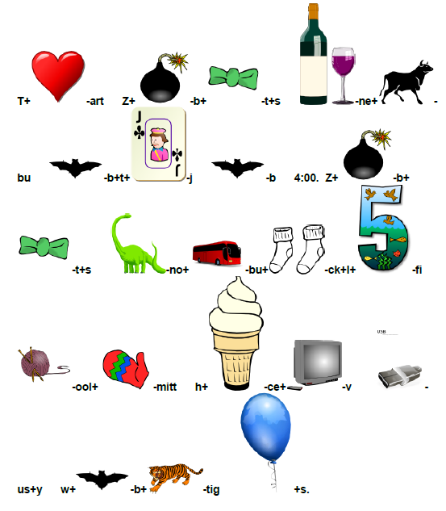

Slide 22
Additional Camporee Events
Zombie Theater: Every Troop is encouraged to have a skit at the campfire on Saturday night. Most importantly…EVERY skit must contain something about Zombies! It’s time to get creative with a new skit or by reworking some of those old skits that we see every Camporee. Costumes are encouraged. An award will be given for the best and most original skit.
Costume Challenge: Turn one of your adult leaders into a terrifying Zombie. Some say that all adult scout leaders look like Zombies after a day or so in the woods with Scouts! See if you can’t help them to look a little more Zombie-like. Costume and make-up are by the youth, the leader is just the model!
Zombie Spirit/Costume Contest: This award will go to the Troop with the highest percentage of participating individuals combined with the best costumes/make-up and the leader most like a Zombie from the above Costume Challenge.
Zombie Cook Off: Every unit needs to produce a main dish, dessert, or appetizer based on the Zombie theme. These will be judged by the camporee staff at supper on Saturday. The recipe should be included with every submittal. Please be aware that poisoning of the staff will not be looked upon favorably and is grounds for disqualification.

Slide 23
Event Champion Plaque Design
Zombie Apocalypse
Survival Team Champions
Wood District Camporee

Slide 24
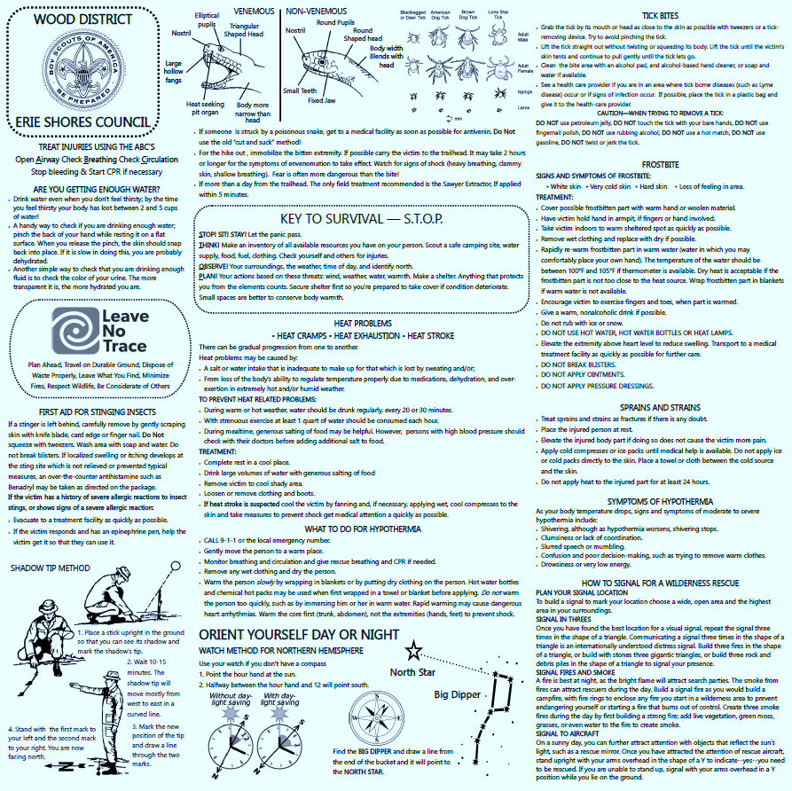
Participation Award
All participants received a safety bandana rather than a patch.

Slide 25
Zombie Invasion Evaluation Form
Paperwork is the most exciting part of the camporee! Well, no...actually that's totally not true. But for the folks running the camporee, reading all the positive comments from Scouts and Scouters is plenty exciting; and heartwarming too. And for those attendees who might be less than satisfied, a nice evaluation form is the perfect opportunity for them to express their dissatisfaction with constructive criticism so camporees can be improved in the future. Besides, how else will we know who to recruit to help enhance things next time!
Rate the following on a scale of 1-5 with 5 being the best. Please include comments.
Location (Camp and Facilities) 1 2 3 4 5 Suggestions for other locations:
Information Package (overall) 1 2 3 4 5
Did it help prepare you for this weekend? 1 2 3 4 5
Did you receive it in time? 1 2 3 4 5 (1 Way too late, 5 Right when I needed it.)
Was any information missing that should have been included? Yes No (If yes, please explain)

Slide 26
Zombie Invasion Evaluation Form
Staff (Overall) 1 2 3 4 5
Ease of Registration 1 2 3 4 5
Was Staff Responsive? 1 2 3 4 5
Event/Station Locations (overall) 1 2 3 4 5
Logical, not too difficult to find with map and GPS coordinates 1 2 3 4 5
Were needed supplies available at the event? 1 2 3 4 5
Survival Lunch
Quality of food 1 2 3 4 5
Were the quantities served sufficient?
Would you like to continue with a common lunch for everyone or would you prefer for each troop to cook their own? If you would like to do this in the future, what are your ideas for a menu?

Slide 27
Zombie Invasion Evaluation Form
Activities (overall) 1 2 3 4 5
Fit with theme 1 2 3 4 5
Personnel adequately trained and prepared to run the activities 1 2 3 4 5
Were the activities interesting? 1 2 3 4 5
Difficulty level of Activities (Circle one)
Infected Leader Too Easy Just Right Impossible
Pyromania Too Easy Just Right Impossible
Finding the Cure Too Easy Just Right Impossible
Monster Mash Too Easy Just Right Impossible
Defend the Camp Too Easy Just Right Impossible
Be Prepared or Prepare to be Prepared Too Easy Just Right Impossible
Escape through the Barbed Wire Too Easy Just Right Impossible
Signal for Rescue Too Easy Just Right Impossible
Move the Zombie Head Too Easy Just Right Impossible
Improve Your Fortifications Too Easy Just Right Impossible

Slide 28
Zombie Invasion Evaluation Form
Other Activities
Undead Head Tournament Cool Idea OK Forget It
Zombie Theater Cool Idea OK Forget It
Zombie Spirit/Costume Contest Cool Idea OK Forget It
Zombie Cook-off Cool Idea OK Forget It
Please comment on any activities that you particularly liked or disliked.
Campfire (overall) 1 2 3 4 5
Scout Vespers program 1 2 3 4 5
Awards Presentations 1 2 3 4 5

Slide 29
Zombie Invasion Evaluation Form
Bandanas (Circle one) Cool Idea They were OK Stick with Patches Other Ideas:
Would you like to see this theme again sometime in the future? 1 2 3 4 5
Suggestions: (What else did we do wrong or get right? How can we improve for next time?)
Would you like to help plan a future Camporee?
_____Yes, count me in.
_____Don't know, contact me when it's time.
_____Time is money, but I might be able to help out in a limited capacity.
If you are able to help, please fill out the information below:
Name: Phone:
E-mail: Unit:

Slide 30
Complete Camporee Themes

Slide 31
Complete Camporee Themes

Slide 32
Complete Camporee Themes

Slide 33
Complete Camporee Themes

Slide 34
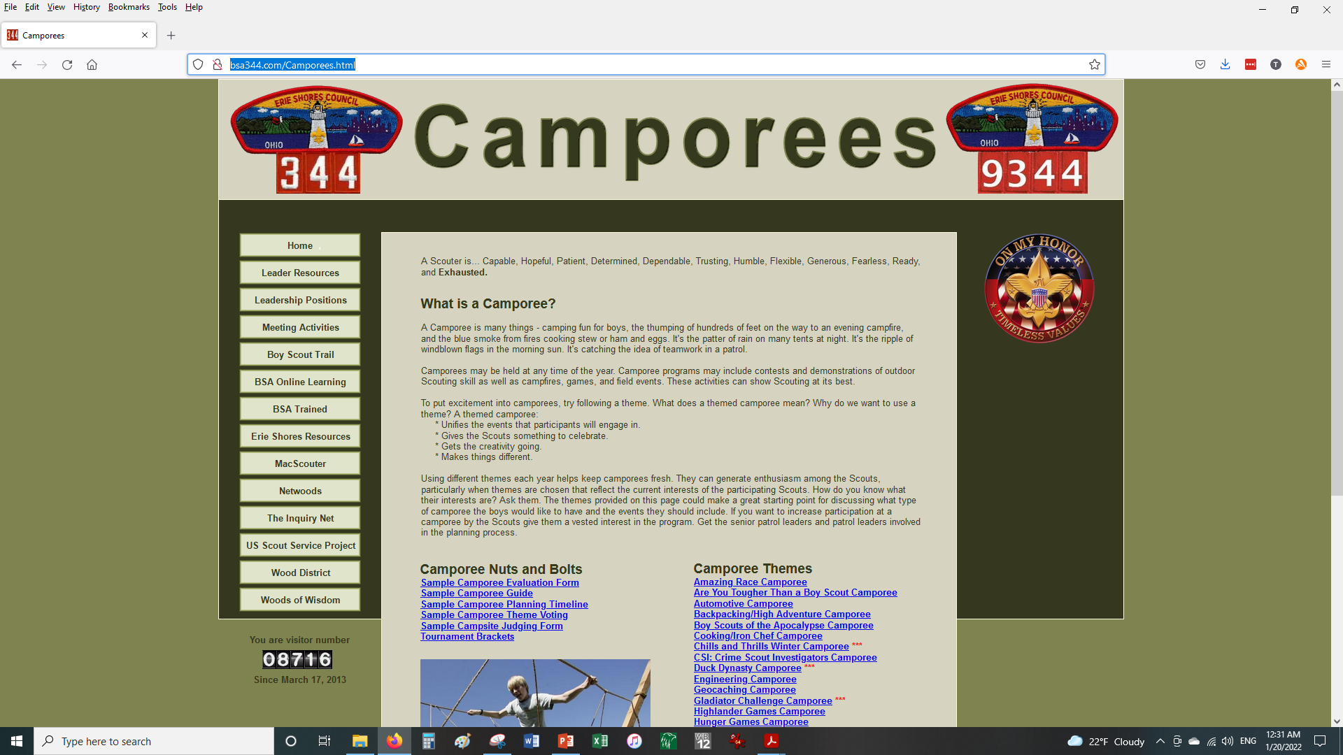
Camporee information can be found at
http://bsa344.com/Camporees.html

Slide 35
Questions?
Terry McKibben
Assistant Scoutmaster
BSA Troop 344/9344
Pemberville, OH
troop344leaders@gmail.com

